Slide 1

Collaboratively working on reproducible manuscripts via R Markdown and GitHub
Alexander Strobel Christoph Scheffel Josephine Zerna

Slide 2



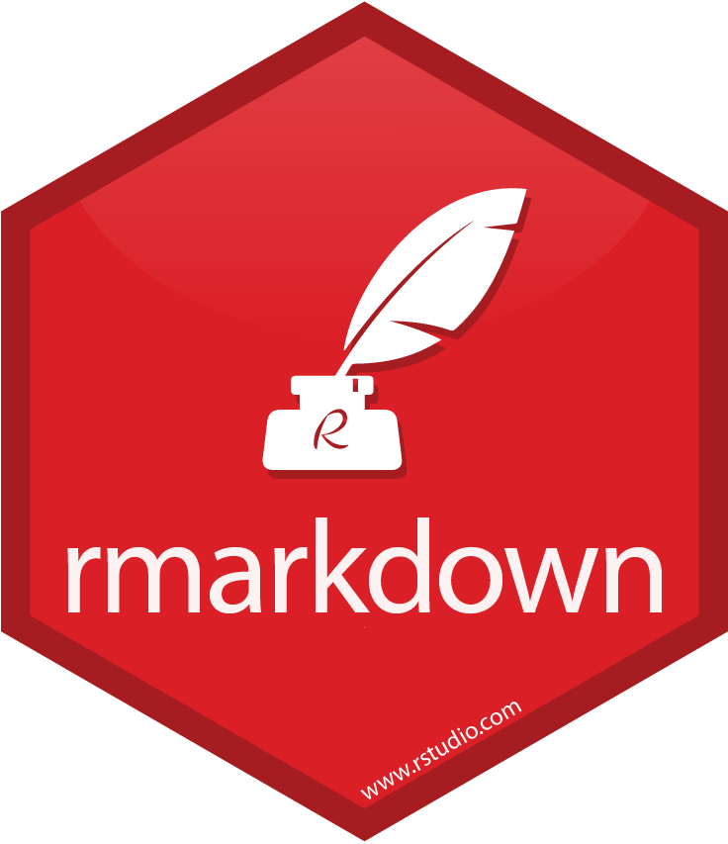


Outline
R
Markdown
R Markdown
GitHub
Recommended R packages
Recommended tools
Ultimate Goal
provide open data and code to ensure transparency
effectively
efficiently
reproducibly
papaja
renv
here
VS Code
GitHub Desktop
3. Open Analysis: (a) Whenever possible, we publish, for every first-authored empirical publication, reproducible data analysis scripts ...

Slide 3

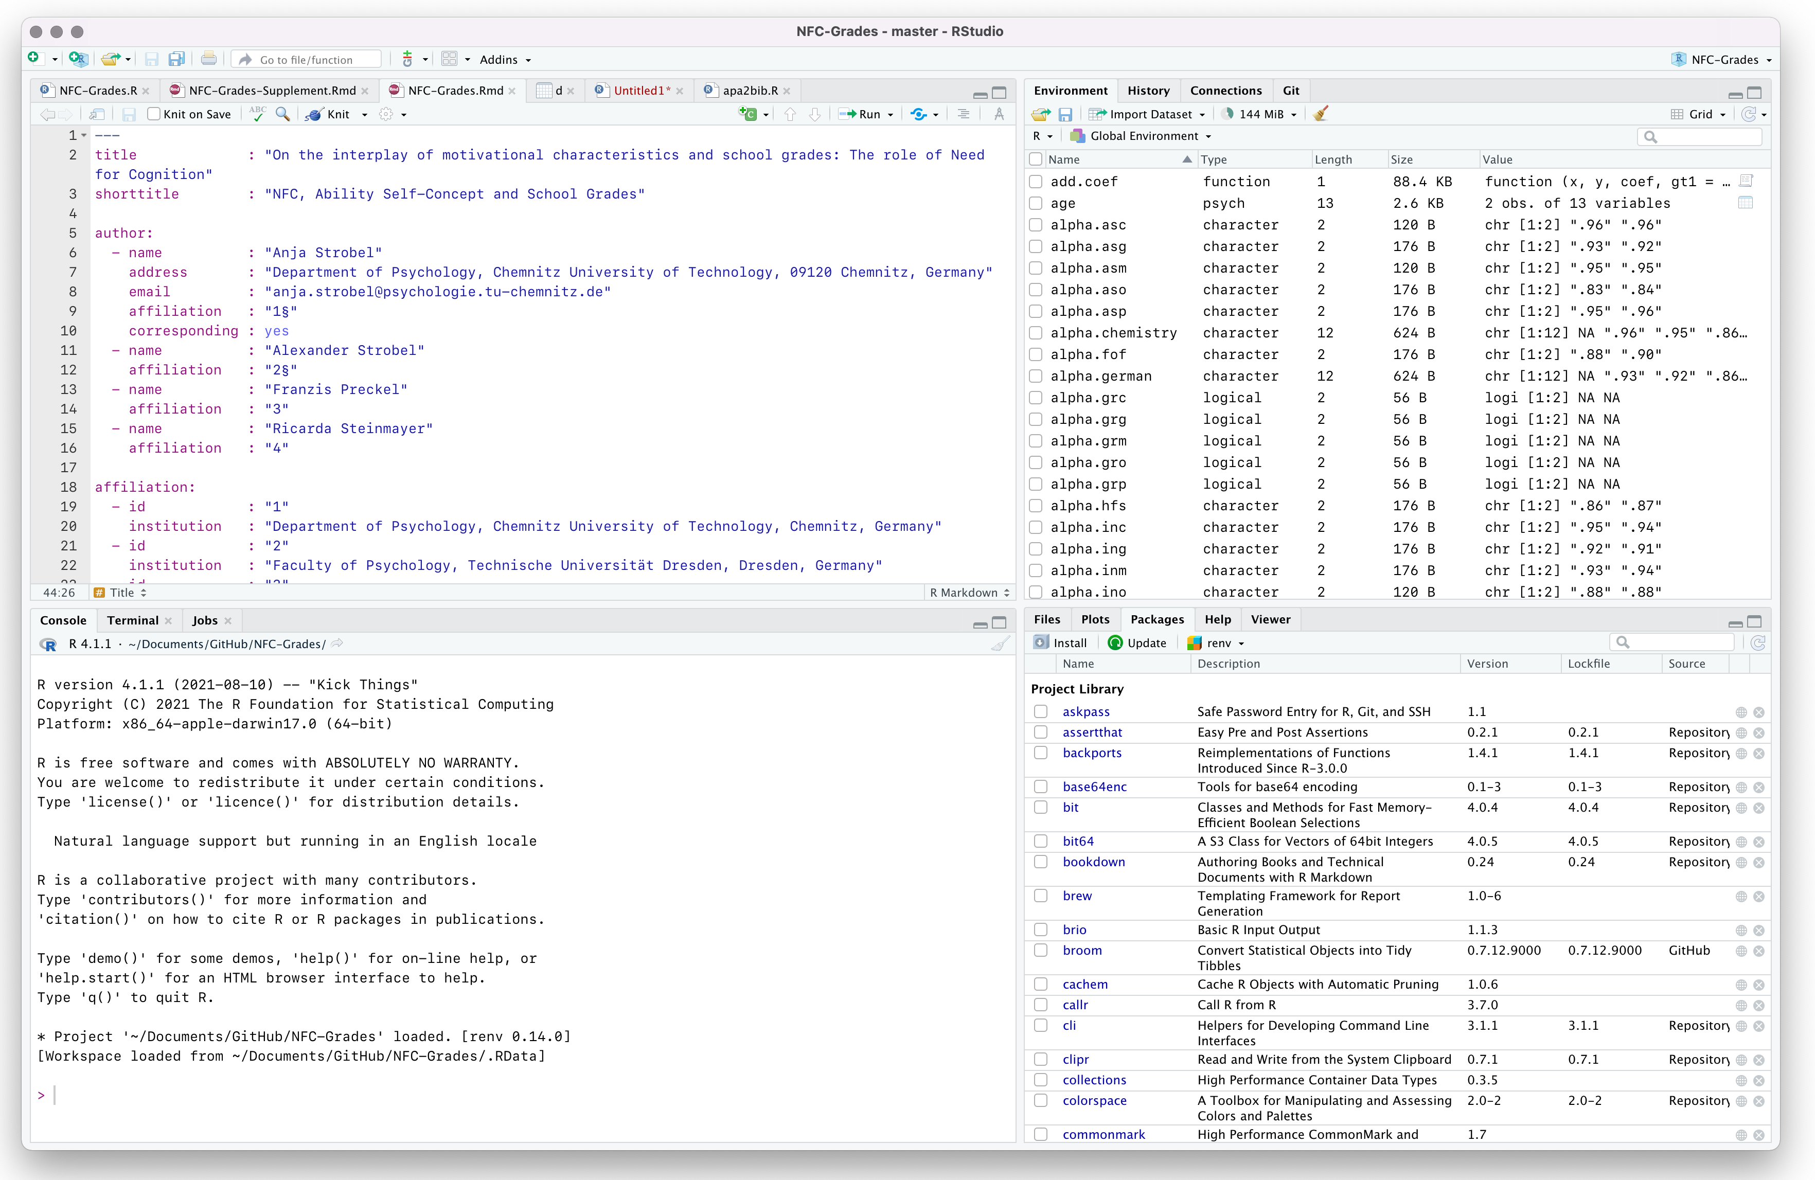
R and RStudio Overview
R
open environment (not only) for statistical computing
easy to learn given basic statistical and programming skills
allows to provide open code along with your data
RStudio
frontend to R (plus has prettier program icon)
comes with a number of benefits compared to stand-alone R including, but not limited to
a graphical user inferface
many built-in features incl. R Markdown
GitHub and Python integration
https://www.r-project.org | https://www.rstudio.com

Slide 4
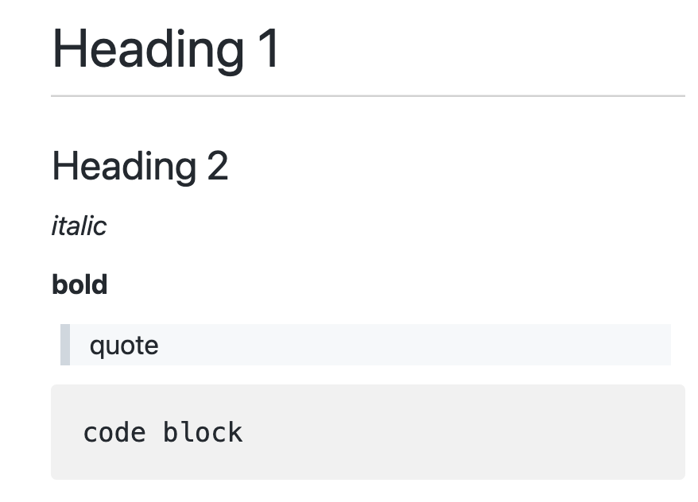
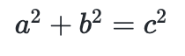
Markdown Overview
Markdown
simplified markup language (i.e., an easy to learn alternative to HTML)
allows to format documents in an easy way, e.g.
# Heading 1
## Heading 2
*italic*
**bold**
> quote
```
Code block
```
$a^2 + b^2 = c^2$

Slide 5
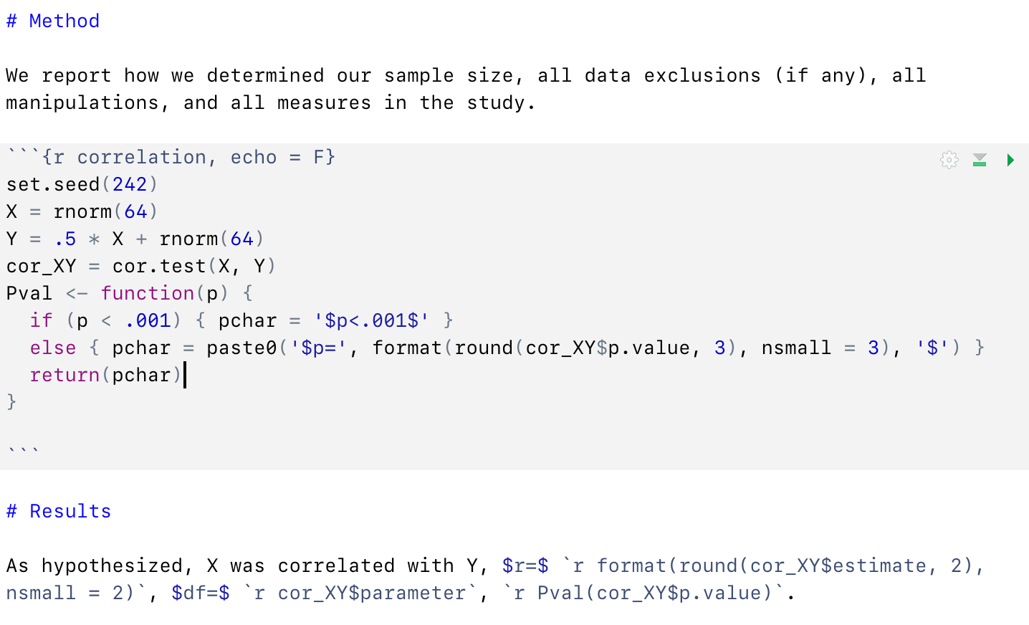
R Markdown Overview
R Markdown
combines the benefits of R and Markdown (and LaTeX), i.e., one writes text in markdown and includes R code in so-called R code chunks, e.g.
Requirements
one needs to have R, RStudio & a LaTeX bundle installed, if not (or if there is an error) just type
tinytex::install_tinytex()
RStudio then
takes the R Markdown file
performs all statistical analyses
places their results where you want them to appear in the format you want to have
translates everything into a LaTeX file and compiles it to a PDF (or HTML/DOCX)
one needs to have some conception on how the results of statistical analyses should be reported and where in some R object they are stored
https://rmarkdown.rstudio.com

Slide 6
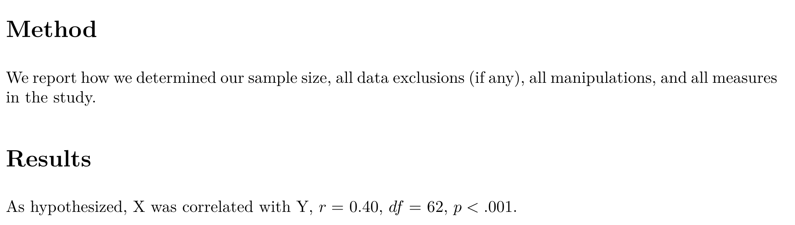
R Markdown Overview
R Markdown
combines the benefits of R and Markdown (and LaTeX), i.e., one writes text in markdown and includes R code in so-called R code chunks, e.g.
Compiled PDF
looks like this (even if you do not know the exact results in advance, because you defined placeholders in the Results section):

Slide 7
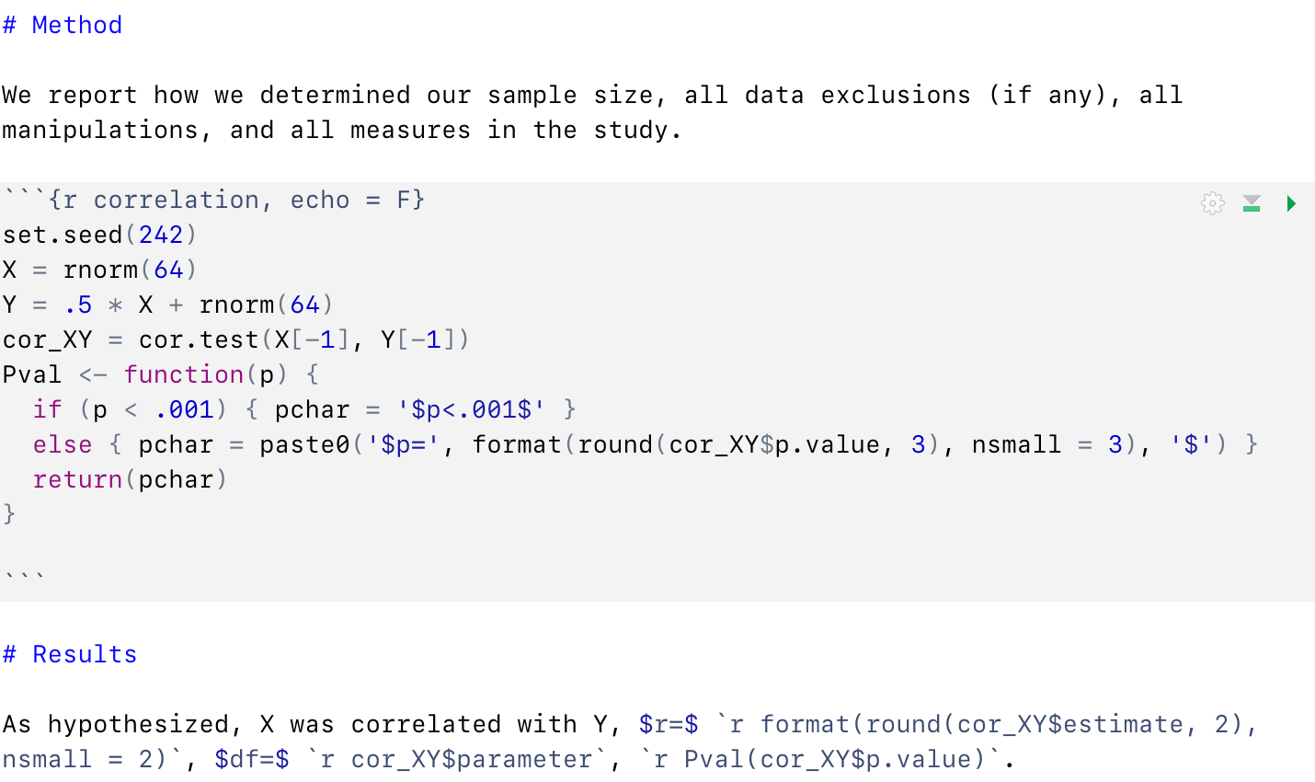
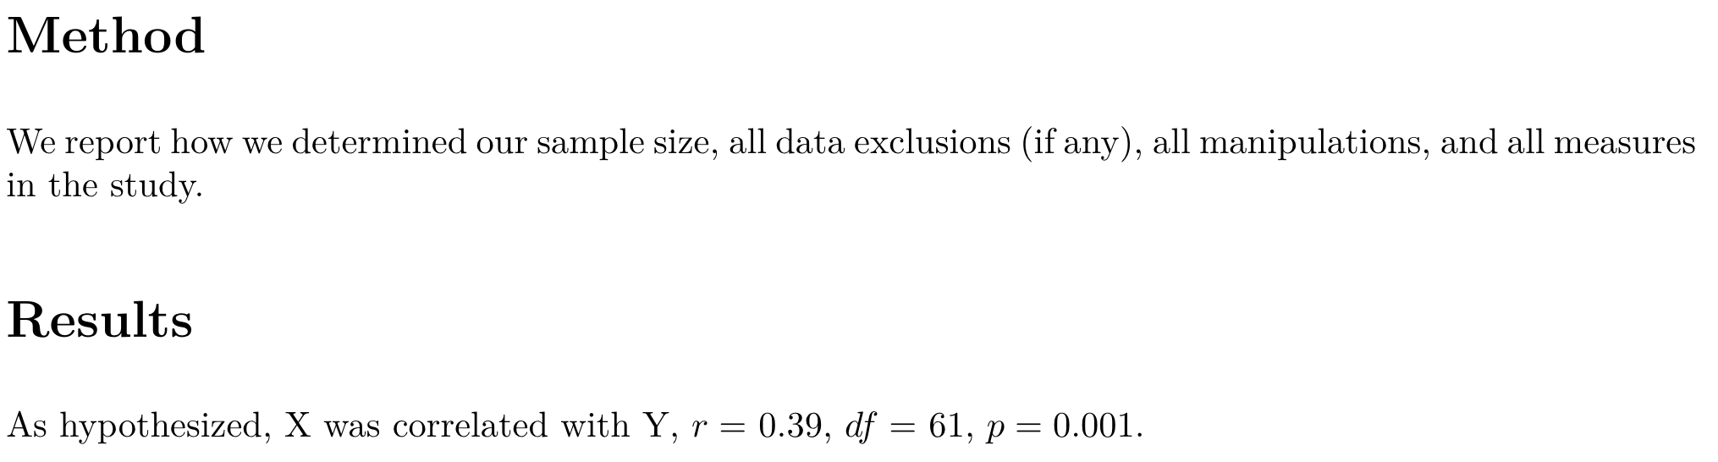
R Markdown Dynamic documents
R Markdown
allows for dynamic documents, i.e., if code changes, the document is updated and gives the correct results (no need to revise text by hand)
Compiled PDF
looks like this (after you removed observation 1 that was you for testing purposes) because you defined placeholders in the Results section:
first step towards computational reproducibility because R code and text are tightly intertwined
Great talk of Russ Poldrack on computational reproducibility
https://www.youtube.com/watch?v=XjW3t-qXAiE

Slide 8
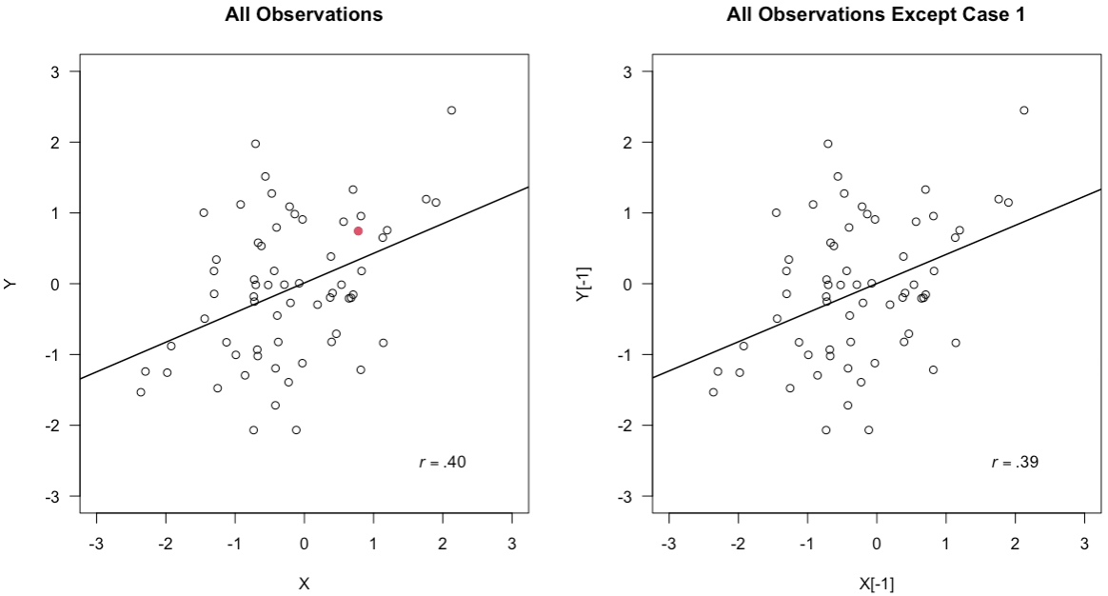
R Markdown Graphics integration
R Markdown
allows for integration of (updateable) graphics, so there is no need to create a new figure after something has changed
Compiled PDF
looks like this (after you removed observation 1 that was you for testing purposes) as figures are create everytime anew if there were changes

Slide 9
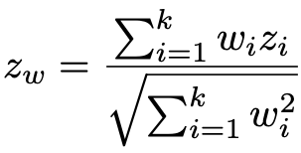
R Markdown LaTeX integration
R Markdown
requires some basic knowledge about LaTeX, as a number of formatting resorts to (or can be easier implemented with) LaTeX
Compiled PDF
nicely formats text marked as LaTeX via $...$ in the preferred way, i.e., statistical coefficients are printed in italics:
also allows for more complex formulae such as
$$z_{w} = \frac{\sum_{i=1}^{k}w_{i}z_{i}}{\sqrt{\sum_{i=1}^{k}w_{i}^2}}$$

Slide 10
R Markdown BibTeX integration
R Markdown
requires some basic knowledge about BibTeX, as citation works via BibTeX (a standard all journals offer and references managers can handle)
Compiled PDF
pastes reference according to some predefined *.csl (= citation language stylesheet) in the way you or the journal wants to have them
the respective BibTeX entry and ref. look like this:
@article{Simmons2012,
author = {J. P. Simmons and L. D. Nelson and U. Simonsohn},
year = {2012},
title = {A 21 word solution},
url = {http://papers.ssrn.com/sol3/papers.cfm?abstract_id=2160588},
doi = {10.2139/ssrn.2160588},
}
[cf. @Simmons2012].
(cf. Simmons et al., 2021).

Slide 11
R Markdown One problem
One problem ...
with R Markdown is that one cannot as easily revise or comment on documents as in Word
Here, you want to add a reference to Simmons, Nelson, & Simonsohn (2012)
Here, you want state that according to APA, correlations are printed without leading zeroes

Slide 12
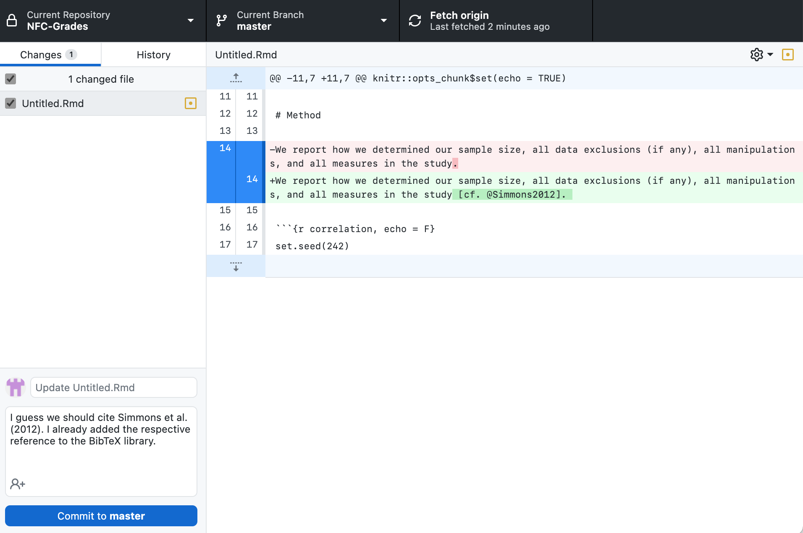
R Markdown One solution
One solution ...
is GitHub, you have version control and can revise documents (and comment on revisions) without permanently changing the document
Here, you add a reference to Simmons, Nelson, & Simonsohn (2012), and the change is highlighted in GitHub Desktop
Here, you comment on your revision.

Slide 13
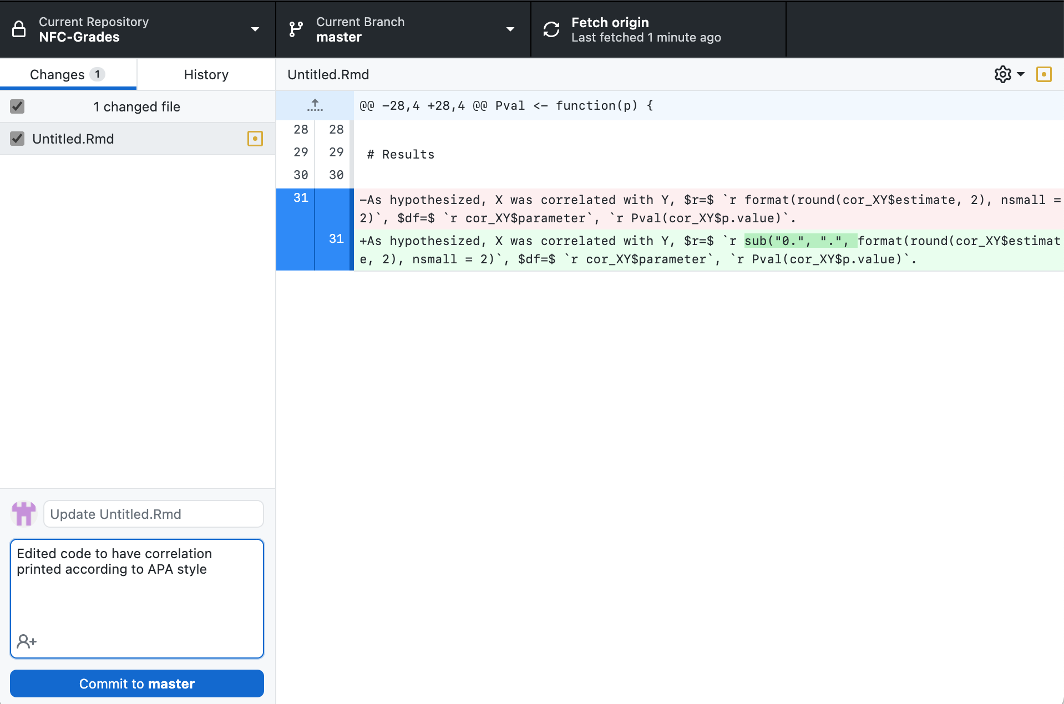
R Markdown One solution
One solution ...
is GitHub, you have version control and can revise documents (and comment on revisions) without permanently changing the document
Here, you change some R code.
And here, you made a coding error, i.e., a missing closing parenthesis, but nevermind: this will stop the document compilation, you will get an error message (although not an informative one most of the time), but you can be assured that the code must work before a document will be compiled.
Here, you comment on your revision.
https://github.com

Slide 14
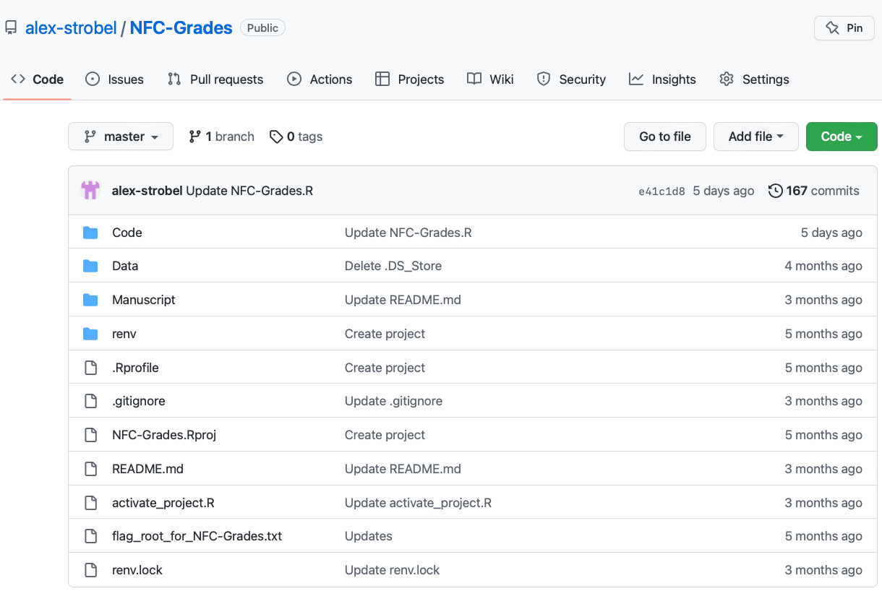
GitHub
GitHub
in case of R Markdown files, a group drive/sharepoint is of limited value, because if something changes, it may not be easy to keep track of these changes
also, if some change eventually results in a dead end, you may want to go back to a previous point in the "timeline" of your project
here, version control is really helpful, and GitHub enables it (in fact, it has been made for it, among others)
the above examples showcase how revisions and comments can be implemented
comes with great features apart from code organization such as Issues and Projects or a Wiki

Slide 15
GitHub Basics
GitHub Basics
GitHub is great for working together on code (in the broadest sense)
comes with version control, so that if something went wrong, you go back in the project timeline, so there is no need for having multiple files to monitor project progress such as Project_final.docx, Project_final2.docx etc. in order to be able to return to earlier project stages
also allows for parallel working on projects on different project branches that are merged in the end, which is especially helpful when working with several co-authors, so no need to integrate multiple word documents
Collaborative writing can of course be done via Google Docs/Sharepoint, yet, there is no (good) version control and working on R/R Markdown code will be not feasible
Version Control
previous stage
current stage
Branching and Merging
project main
merged project
branches
pull request
(discussion of changes)

Slide 16
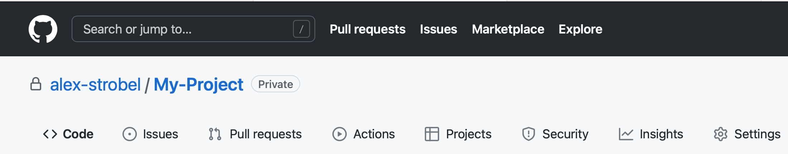
GitHub Workflow
GitHub Workflow
Researcher A creates GitHub repository, invites collaborators B and C via “Settings“
A, B, and C either work together
on the main project „Code“ or
work on separate taks (as defined, e.g., via „Projects“ or „Issues“) or
create a branch from the main timeline and later issue a „Pull request“
organize their collaboration via Issues, Projects and perhaps a Wiki (here not visible)

Slide 17
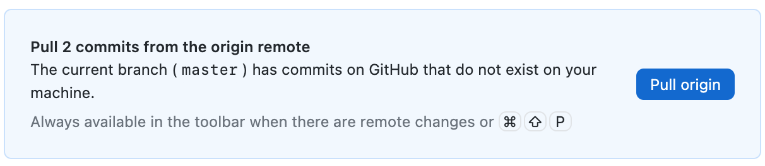
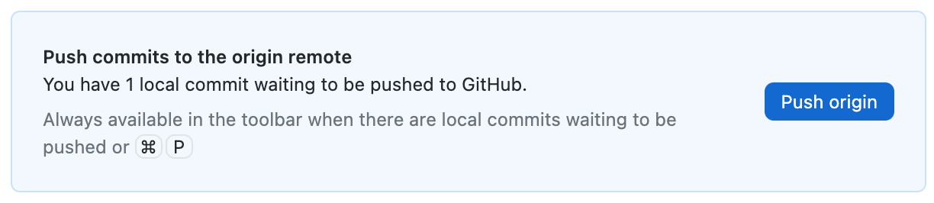
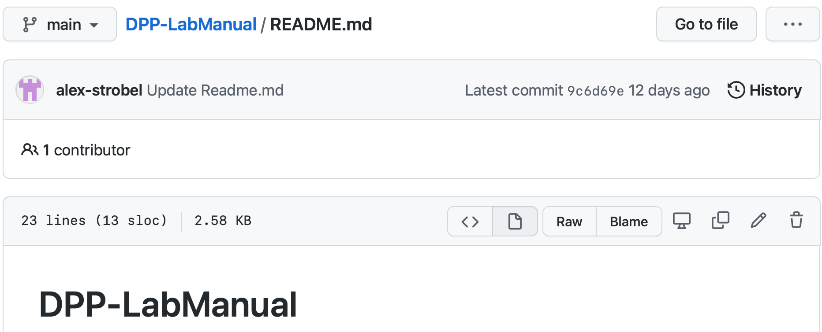
GitHub Drawbacks
GitHub Drawbacks
GitHub has been made by and for people who one could call nerds; so if you aren‘t a bit of a nerd, you might get lost, because of GitHub‘s structure and terminology
GitHub is not immediately compatible with spoken language
retrieving the current project status is called a pull
changing something is called a commit
uploading your changes is called a push
having created a branch and wanting to have it merged with the main project is called a pull-request
synchronizing with GitHub will work differently depending on your OS and code editor; best results IMHO are achieved using GitHub Desktop and/or VisualStudio Code (see below)

Slide 18
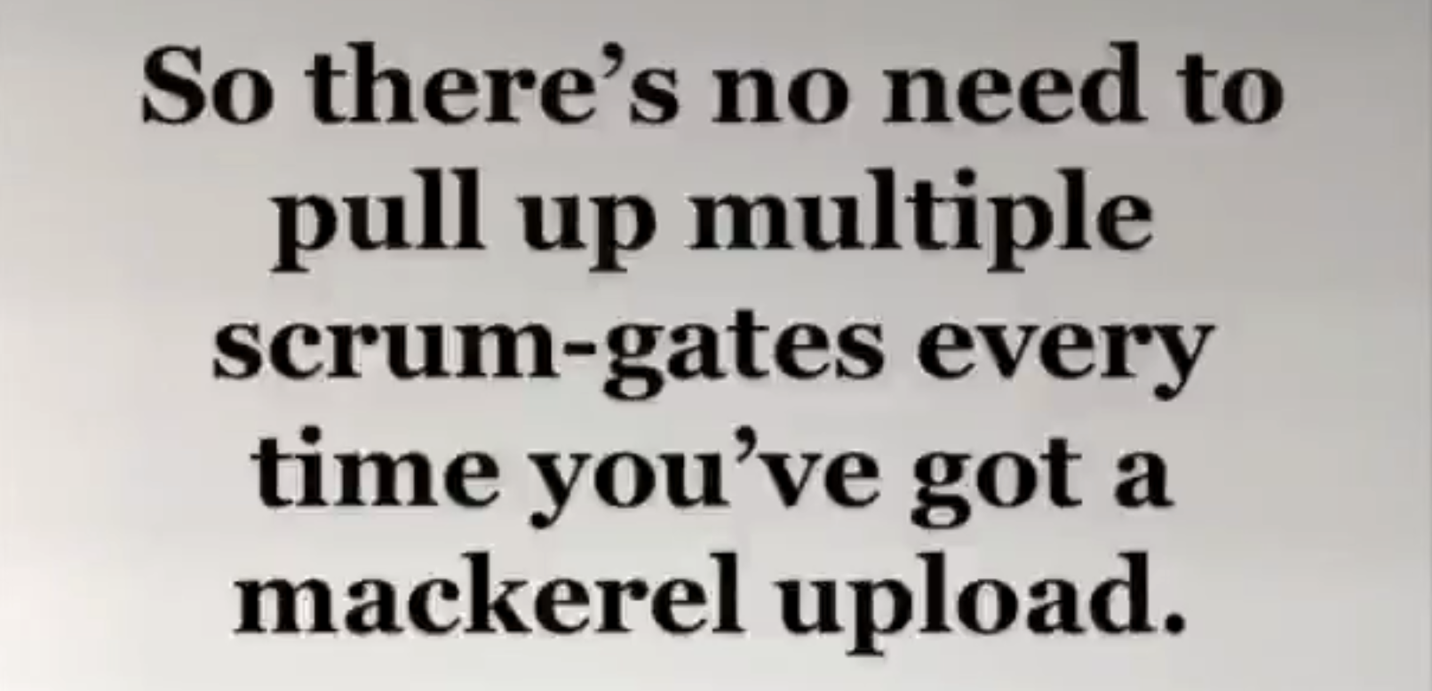
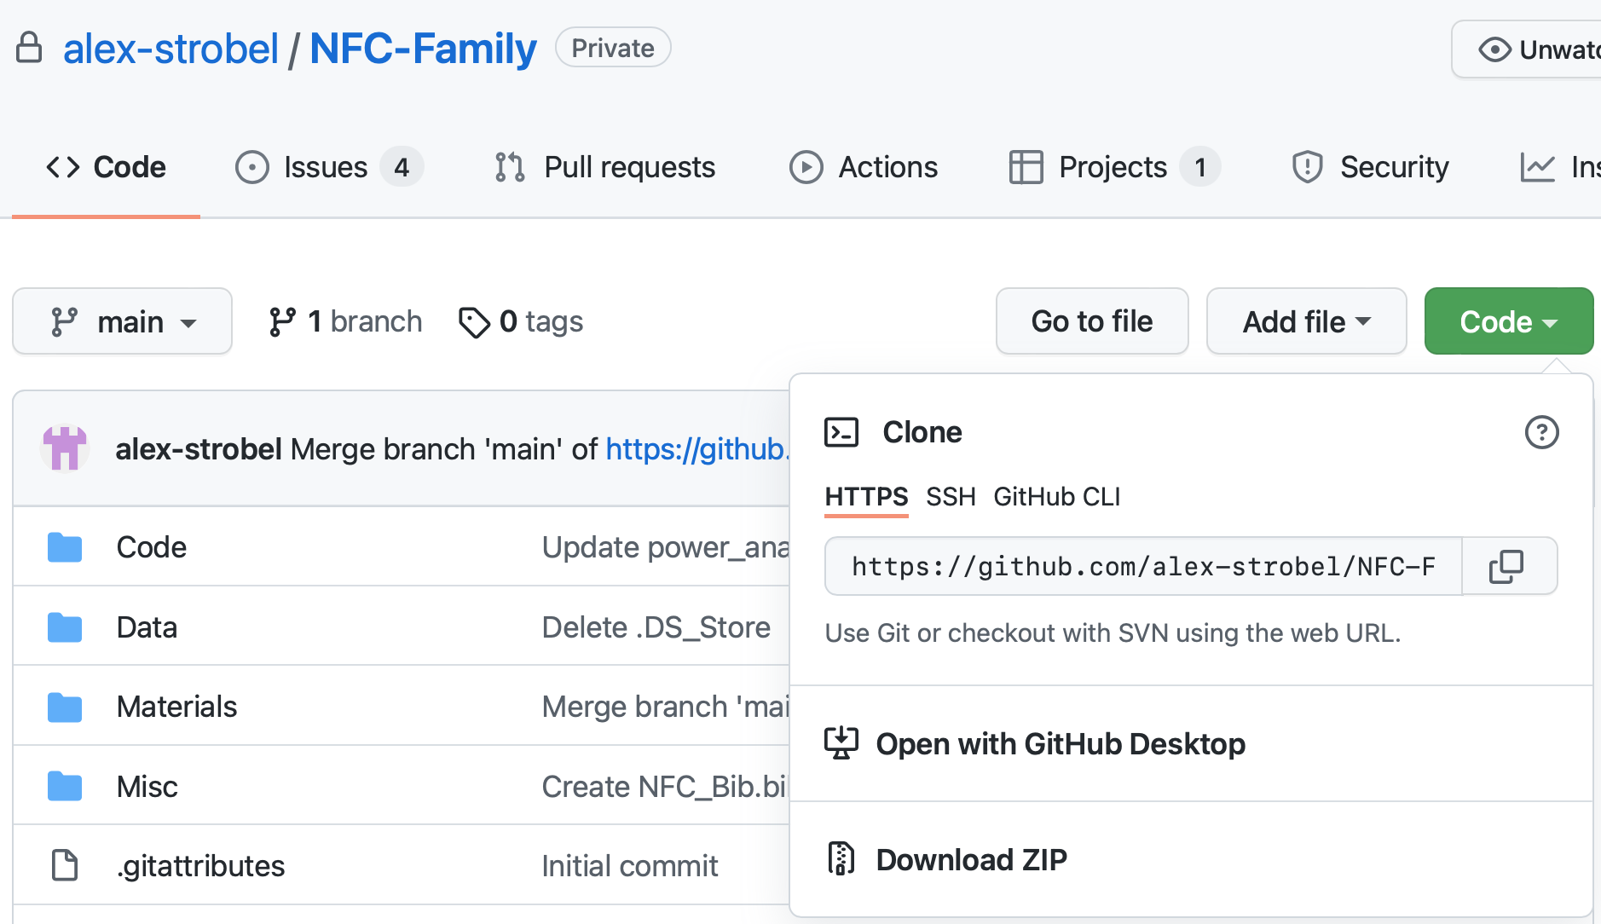
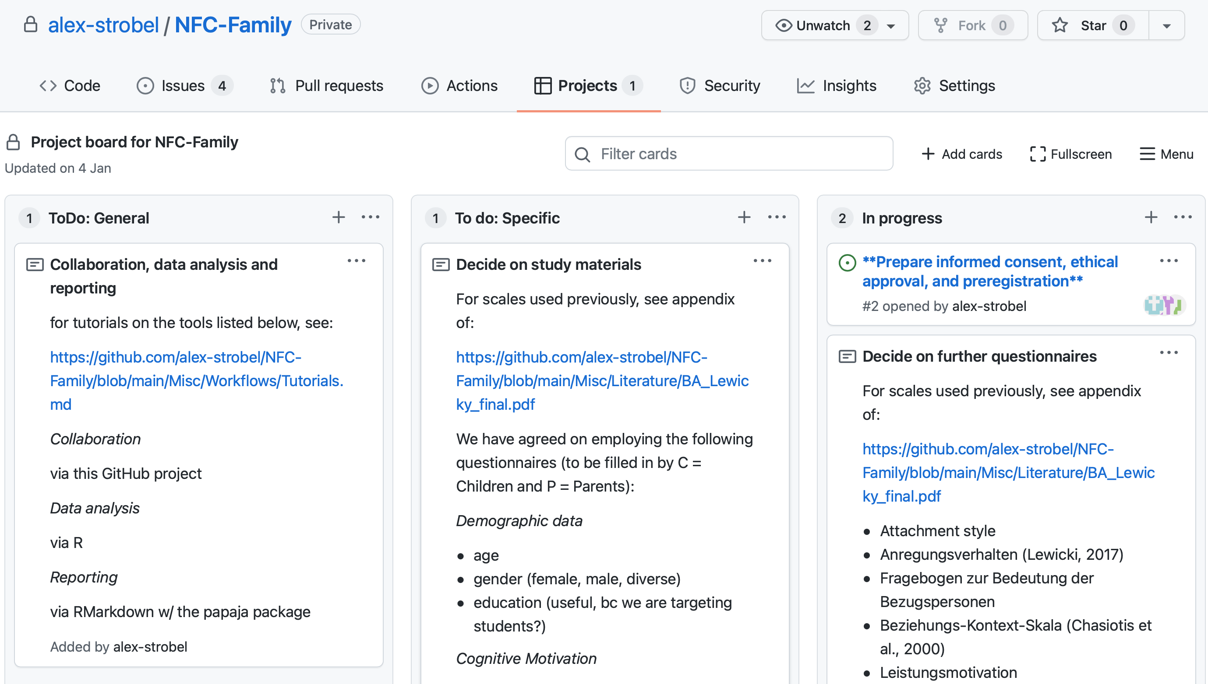
GitHub Benefits
GitHub Benefits
collaboration is as easy as possible
project data and code are in one place and are always up to date
is also great as backup even when working alone on a project
project progress is marked with a time stamp, so all steps are transparent all the time, no one can engage in some HARKing as it will be evident if some hypothesis is added to the manuscript file at a later time point than the analysis code has been updated (can easily be faked of course, but good will presumed ...)
does not only support collaboration, but also sharing of data and code, because a whole project can be downloaded (aka „cloned“) in an instant instead of downloading OSF files one at a time
also has tools for project administration (Issues, Projects) and a built-in Wiki function

Slide 19
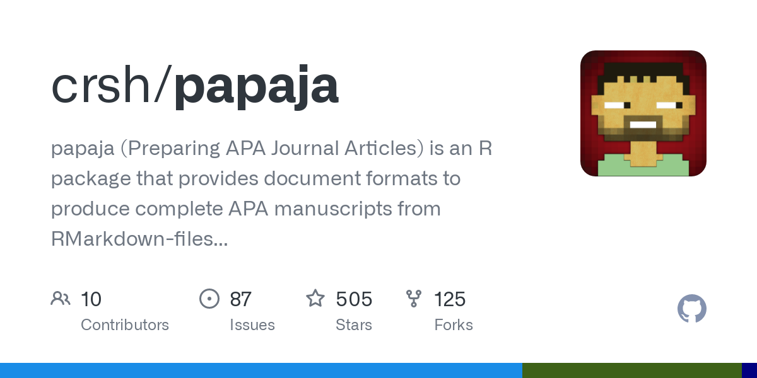


Recommended tools R packages
papaja
lets you format your manuscript in APA6 format and includes a variety of helper functions, e.g., for reporting statistics in a proper (and properly formatted) way
renv
stands for reproducible environment and stores your R analysis environment for a given project, so that people who want to reproduce your results not only have your code but the very R package versions you used
here
assists with regard to file paths; with here, there is no need to edit path names of downloaded or cloned projects
* using renv may sometimes be troublesome, so were are about to go for an alternative tool: conda
https://github.com/crsh/papaja | https://rstudio.github.io/renv/articles/renv.html | https://here.r-lib.org

Slide 20


Recommended tools Software
GitHub Desktop
keeps track of all changes to your GitHub project, be them local or global
will prompt you to pull from the main project time line whenever something has changed and will support you to push changes from your timeline
VisualStudio Code
this program is the code editor to go for, even if you do not want to work with GitHub and R or R Markdown, but like/want/need to work on code
comes with code highlighting depending on the programming language you use, has a preview, has dark mode (some people seem to like this 😉)
https://desktop.github.com | https://code.visualstudio.com

Slide 21

Summary and outlook Summary
Summary
Actually working on R Markdown files with GitHub integration at first might seem like „floxjam.com“:
Yet, after you have familiarized yourself with the terminology and mastered a first small project, you will not want to use other collaboration platforms anymore
Using R Markdown w/ GitHub will also enhance transparency and sharing of data and code
Using helper packages like papaja, renv and here brings added value
Using VisualStudio Code is in itself a great relief when it comes to coding, and together with GitHub, you can use its full potential (and if you have Spotify Premium, you can even listen to your music from within VS Code!)
But don‘t just take my word for it, listen to this woman! 👇🏻
„GitHub makes collaboration so much easier! Everything is in one place and always up to date, no need to keep track of changes by yourself which is especially helpful when using R Markdown. And everything is so much more transparent ...“
Anja Strobel

Slide 22

Summary and outlook Outlook
Drawbacks
actually working on R Markdown files with GitHub will most certainly result in a number of issues
you will initially need to resort to astonishingly incomprehensible help pages (yet, mostly bc of R Markdown)
yet, you will also later on need to resort to astonishingly incomprehensible help pages, so why not start now?!
Benefits
After the first manuscript, you will master R Markdown to some degree and more so after the second, and after the third, you will be annoyed that your co-authors do not know R Markdown, so you have to compile everything to a stupid Word document for them to review/revise it
https://www.exemplifygroup.com/look-benefits-drawbacks-unified-communications/

Slide 23
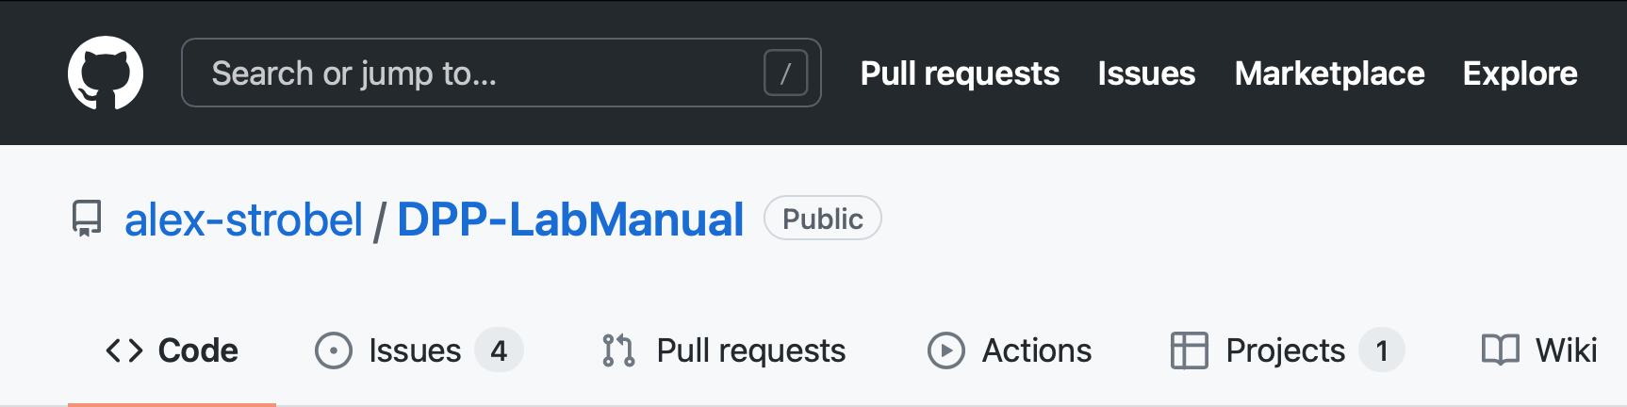
Further resources
GitHub
GitHub's Git Guides
Happy Git With R
R Markdown
R Markdown Guide
R Markdown Cheat Sheet
R Markdown Course (developed by Christoph and me, workshop will be offered as soon as possible)
Using GitHub and renv/here to collaborate on R Markdown projects
our tutorial on collaboration via GitHub (note, we are just about re-organizing our LabManual, so you may need to click through from the root)

Slide 24
Thank you!

Slide 25
Credentials
The creation of this workshop material was partially funded by the by the German Research Foundation (Deutsche Forschungsgemeinschaft, DFG; SFB 940/3)
These slides were created by Alexander Strobel, Christoph Scheffel and Josephine Zerna. The work is licensed under a Creative Commons Attribution 4.0 International License. That means, you can reuse these slides in your own workshops, remix them, or copy them, as long as you attribute the original creator.

